Slide 1

侗族刺绣再生 Regeneration of Dong Embroidery
小组成员：李秦鑫、杨舒淇、尹洁
Group Members: Li Qinxin、Qi、Yin Jie

Slide 2
项目描述：
Description of Project
This project is presented around the “intangible cultural heritage-dong embroidery”. We will use new methods to rearrange Dong embroidery patterns to create awareness around Dong traditional song and dance.
Pattern collection: The collection of patterns mainly comes from three aspects: Daily clothing、 Dong nationality grand song and Dong dance. Daily clothing: Collecting Dong people's clothing and articles used to extract patterns; Dong nationality grand song : Taking "Song of Xia Chan" and "Song of Cicada" as examples, two music scores are formed in a unique arrangement, and the music score is the pattern. Dong dance: Taking the men's group dance "Fish Play" as an example, the dance postures are extracted and compiled into patterns.
Presentation of works:
1) Four pieces 0.5*2m Print embroidery patterns (Fabric printing)
2) Eight dollars 0.2*0.2m Pattern extension (Fabric printing)
3) Digital Presentation of Embroidery(Computer)
此次项目是围绕“非物质文化遗产——侗族刺绣”来呈现的。主要对刺绣的纹样进行采集和整理，我们将运用新的方式来重新排列纹样，使其在具有侗族刺绣的特色的同时能够更好的传播。
1.纹样采集：纹样的采集主要来源于三个方面：日常服饰、侗族大歌和侗族舞蹈。服饰：采集侗族人民的穿着及使用的物品中提取纹样；侗族大歌：以《夏蝉之歌》和《蝉之歌》为例，用特有的排列方式形成两张歌谱，歌谱即纹样；侗族舞蹈：以男子群舞《鱼戏》为例，提取舞蹈姿势，编为纹样。
2.作品呈现：
1）四块 0.5*2m 的打印刺绣纹样（布面打印）
2）八块 0.2*0.2m 的纹样延申(布面打印)
3）刺绣的数字化呈现（电脑）

Slide 3
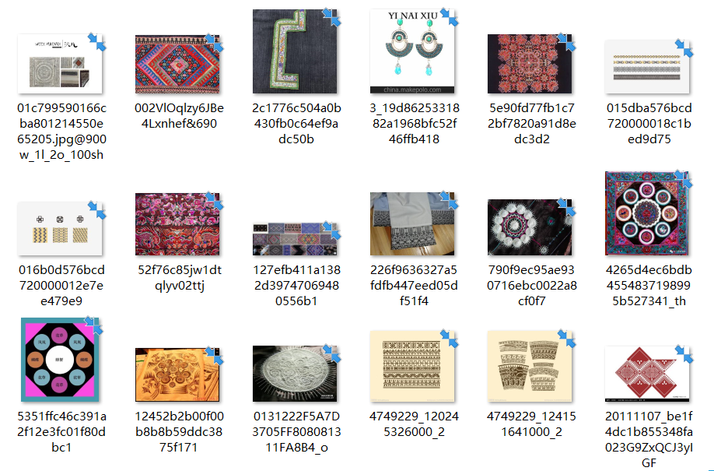
灵感：
Inspiration

Slide 4
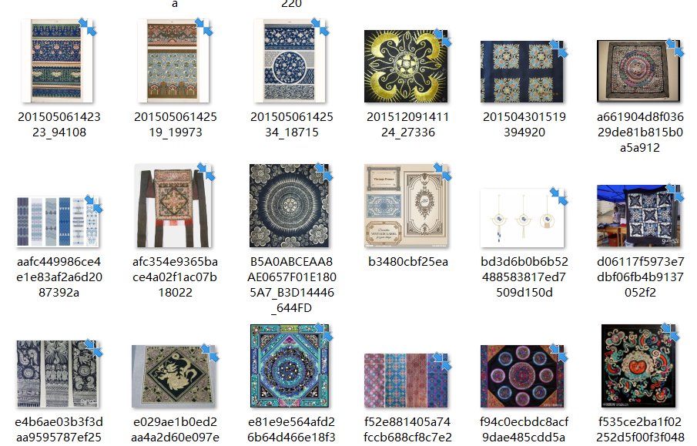

Slide 5
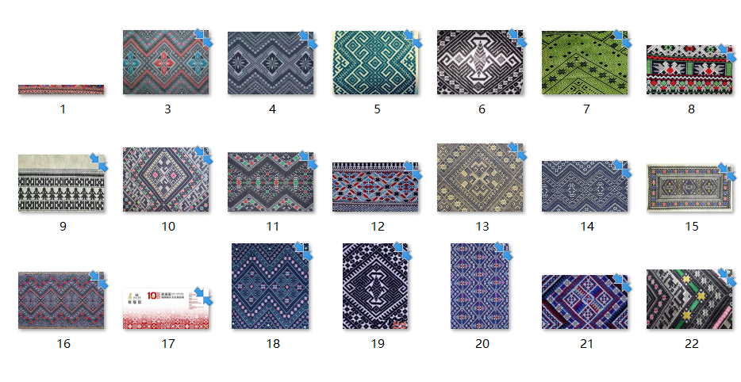
使用数据：
Use Data
使用的部分刺绣纹样
Some Embroidery Patterns Used

Slide 6
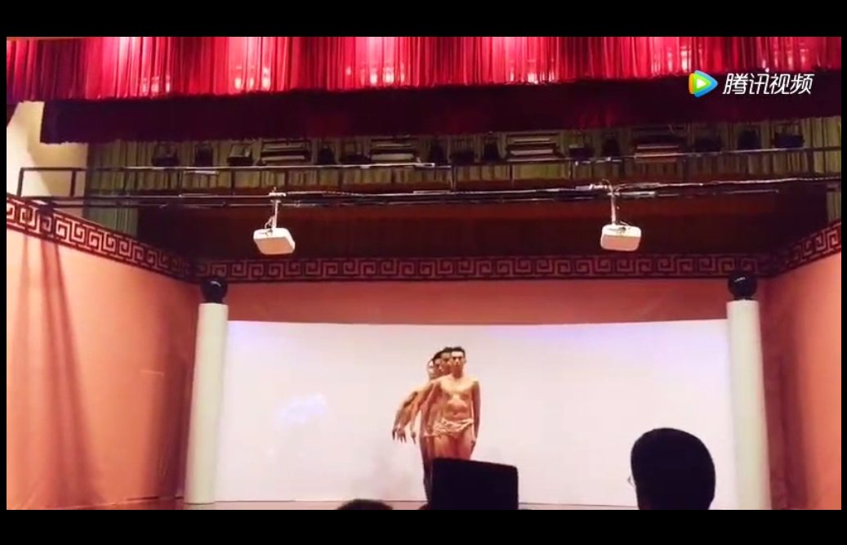
https://b23.tv/av17252167

Slide 7
贵州黔东南侗族大歌《夏蝉之歌》

Slide 8
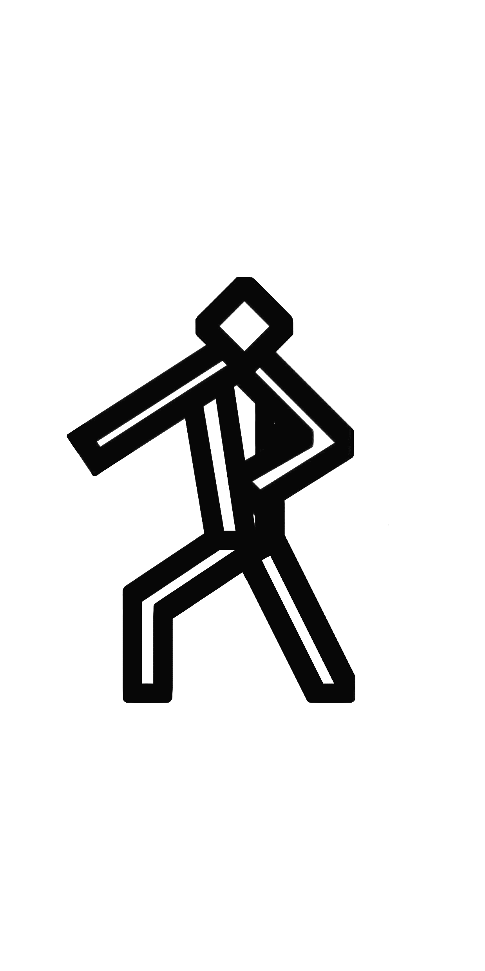
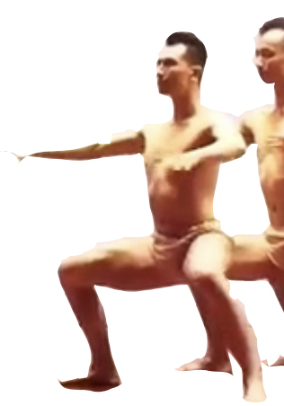

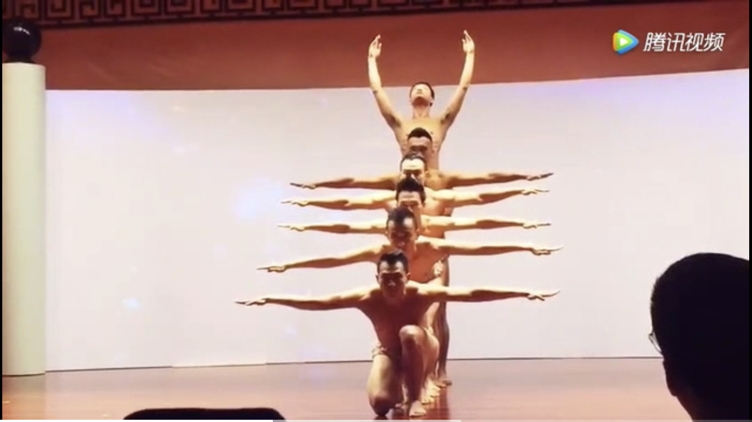
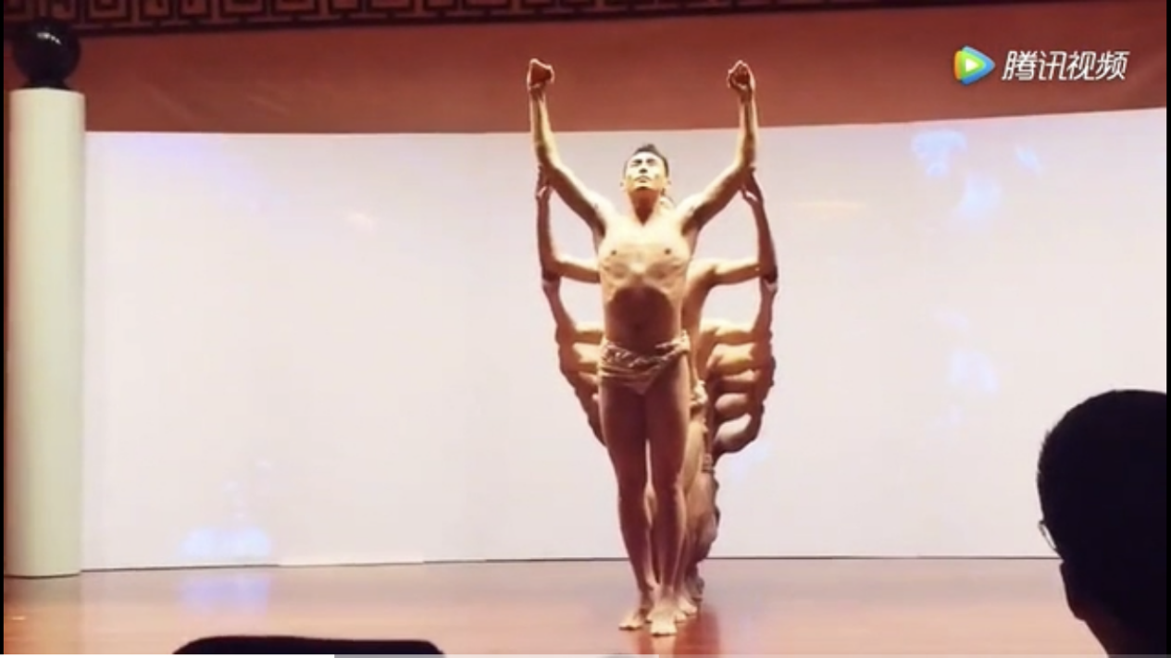
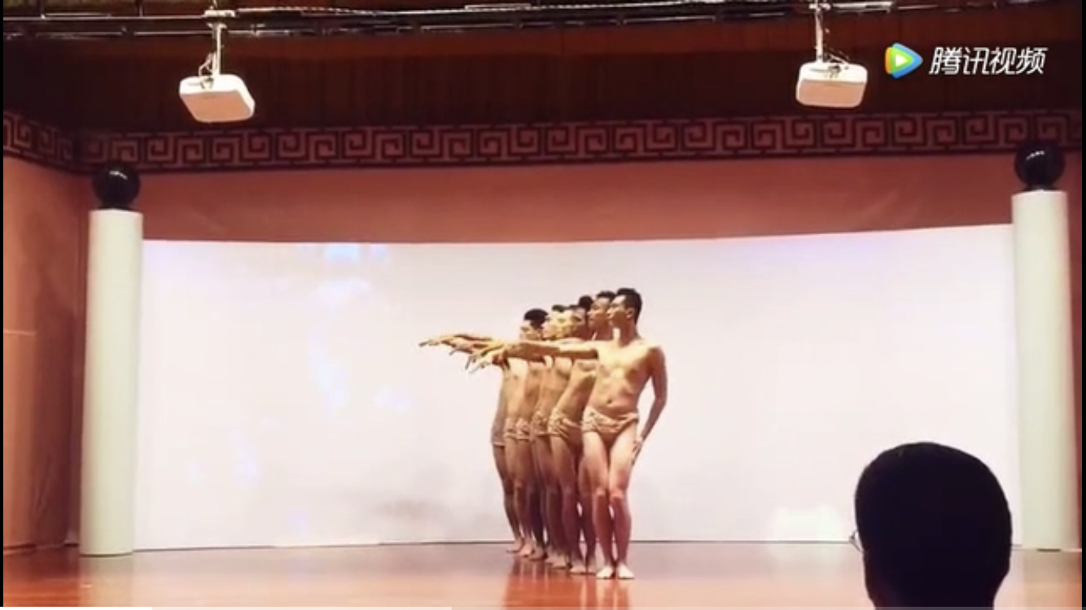
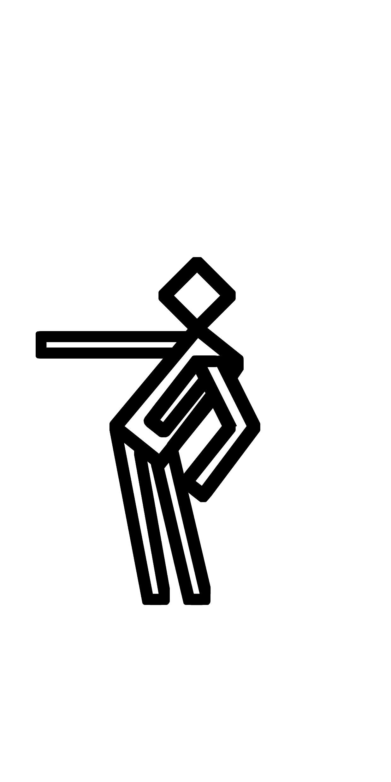

数据翻译：
Data Translation
侗族舞蹈数据翻译
Dong dance data translation
舞蹈符号（一）
Dance Symbol (1)
舞蹈符号（二）
Dance Symbol (2)
舞蹈符号（三）
Dance Symbol (3)
舞蹈符号（四）
Dance Symbol (4)

Slide 9
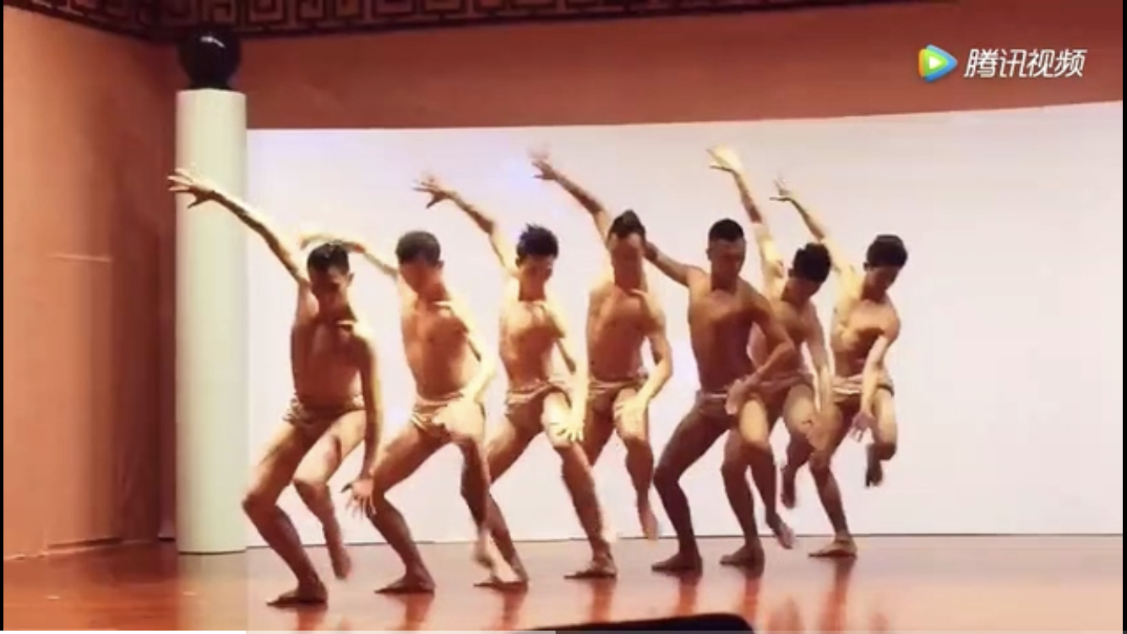
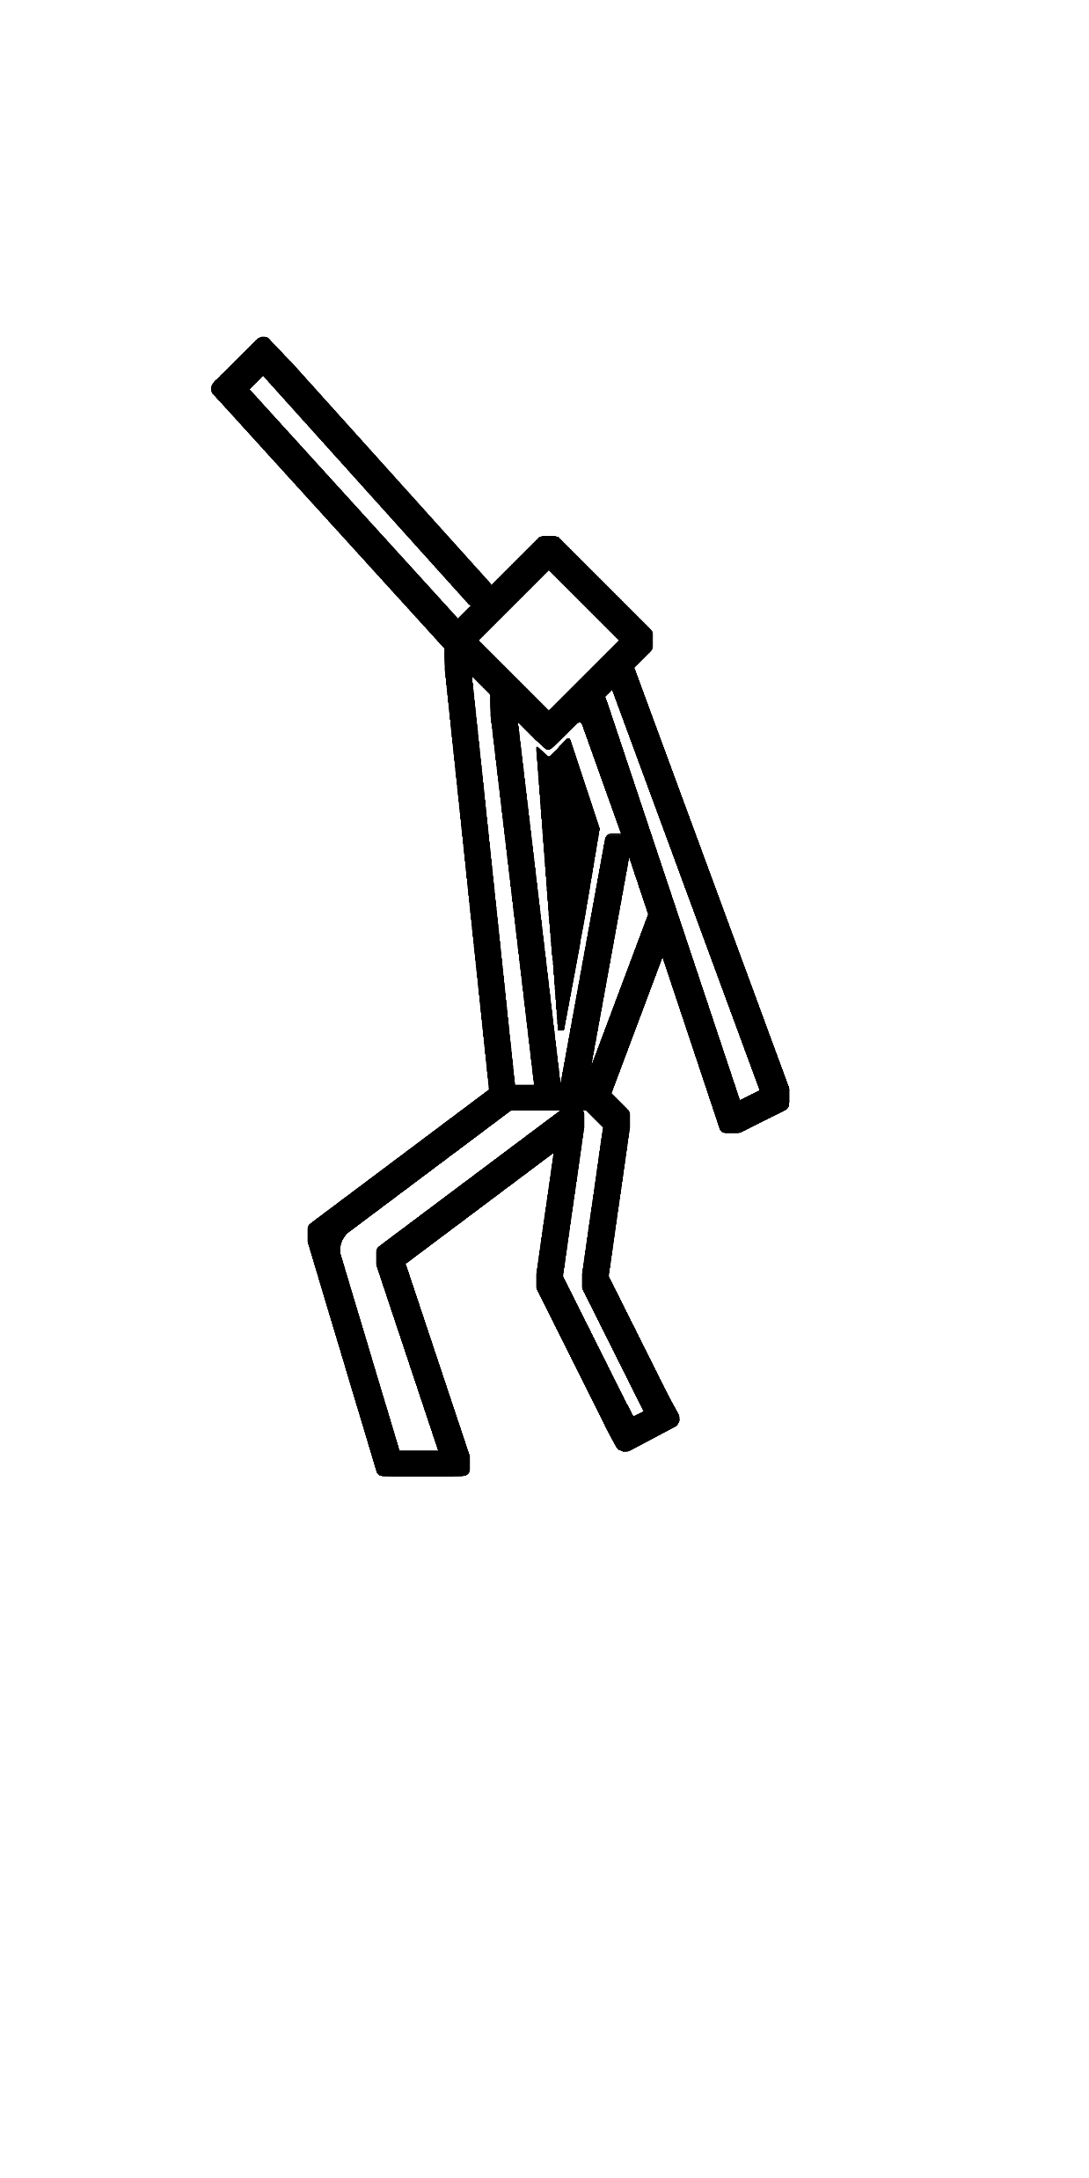
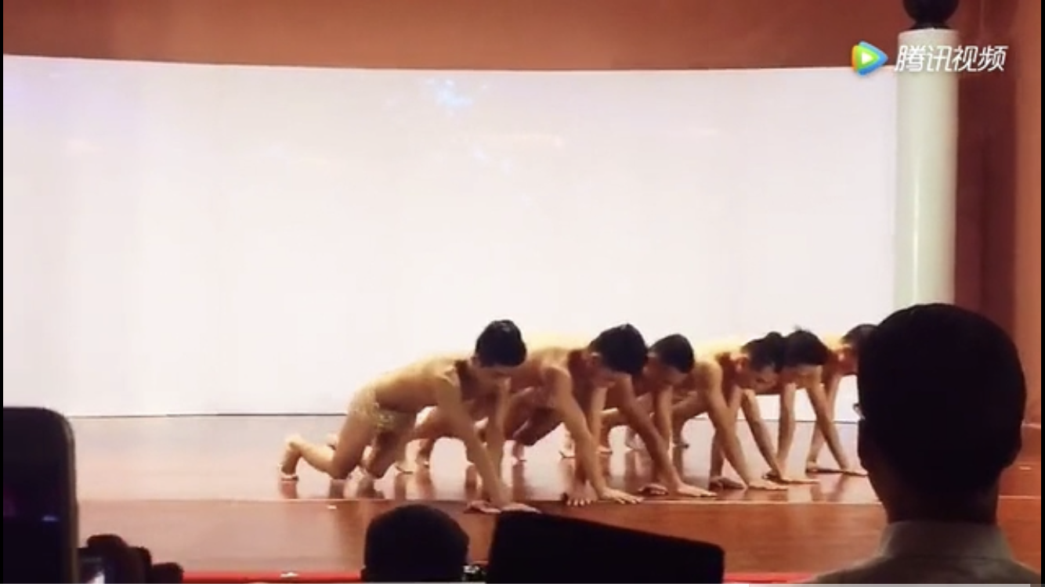
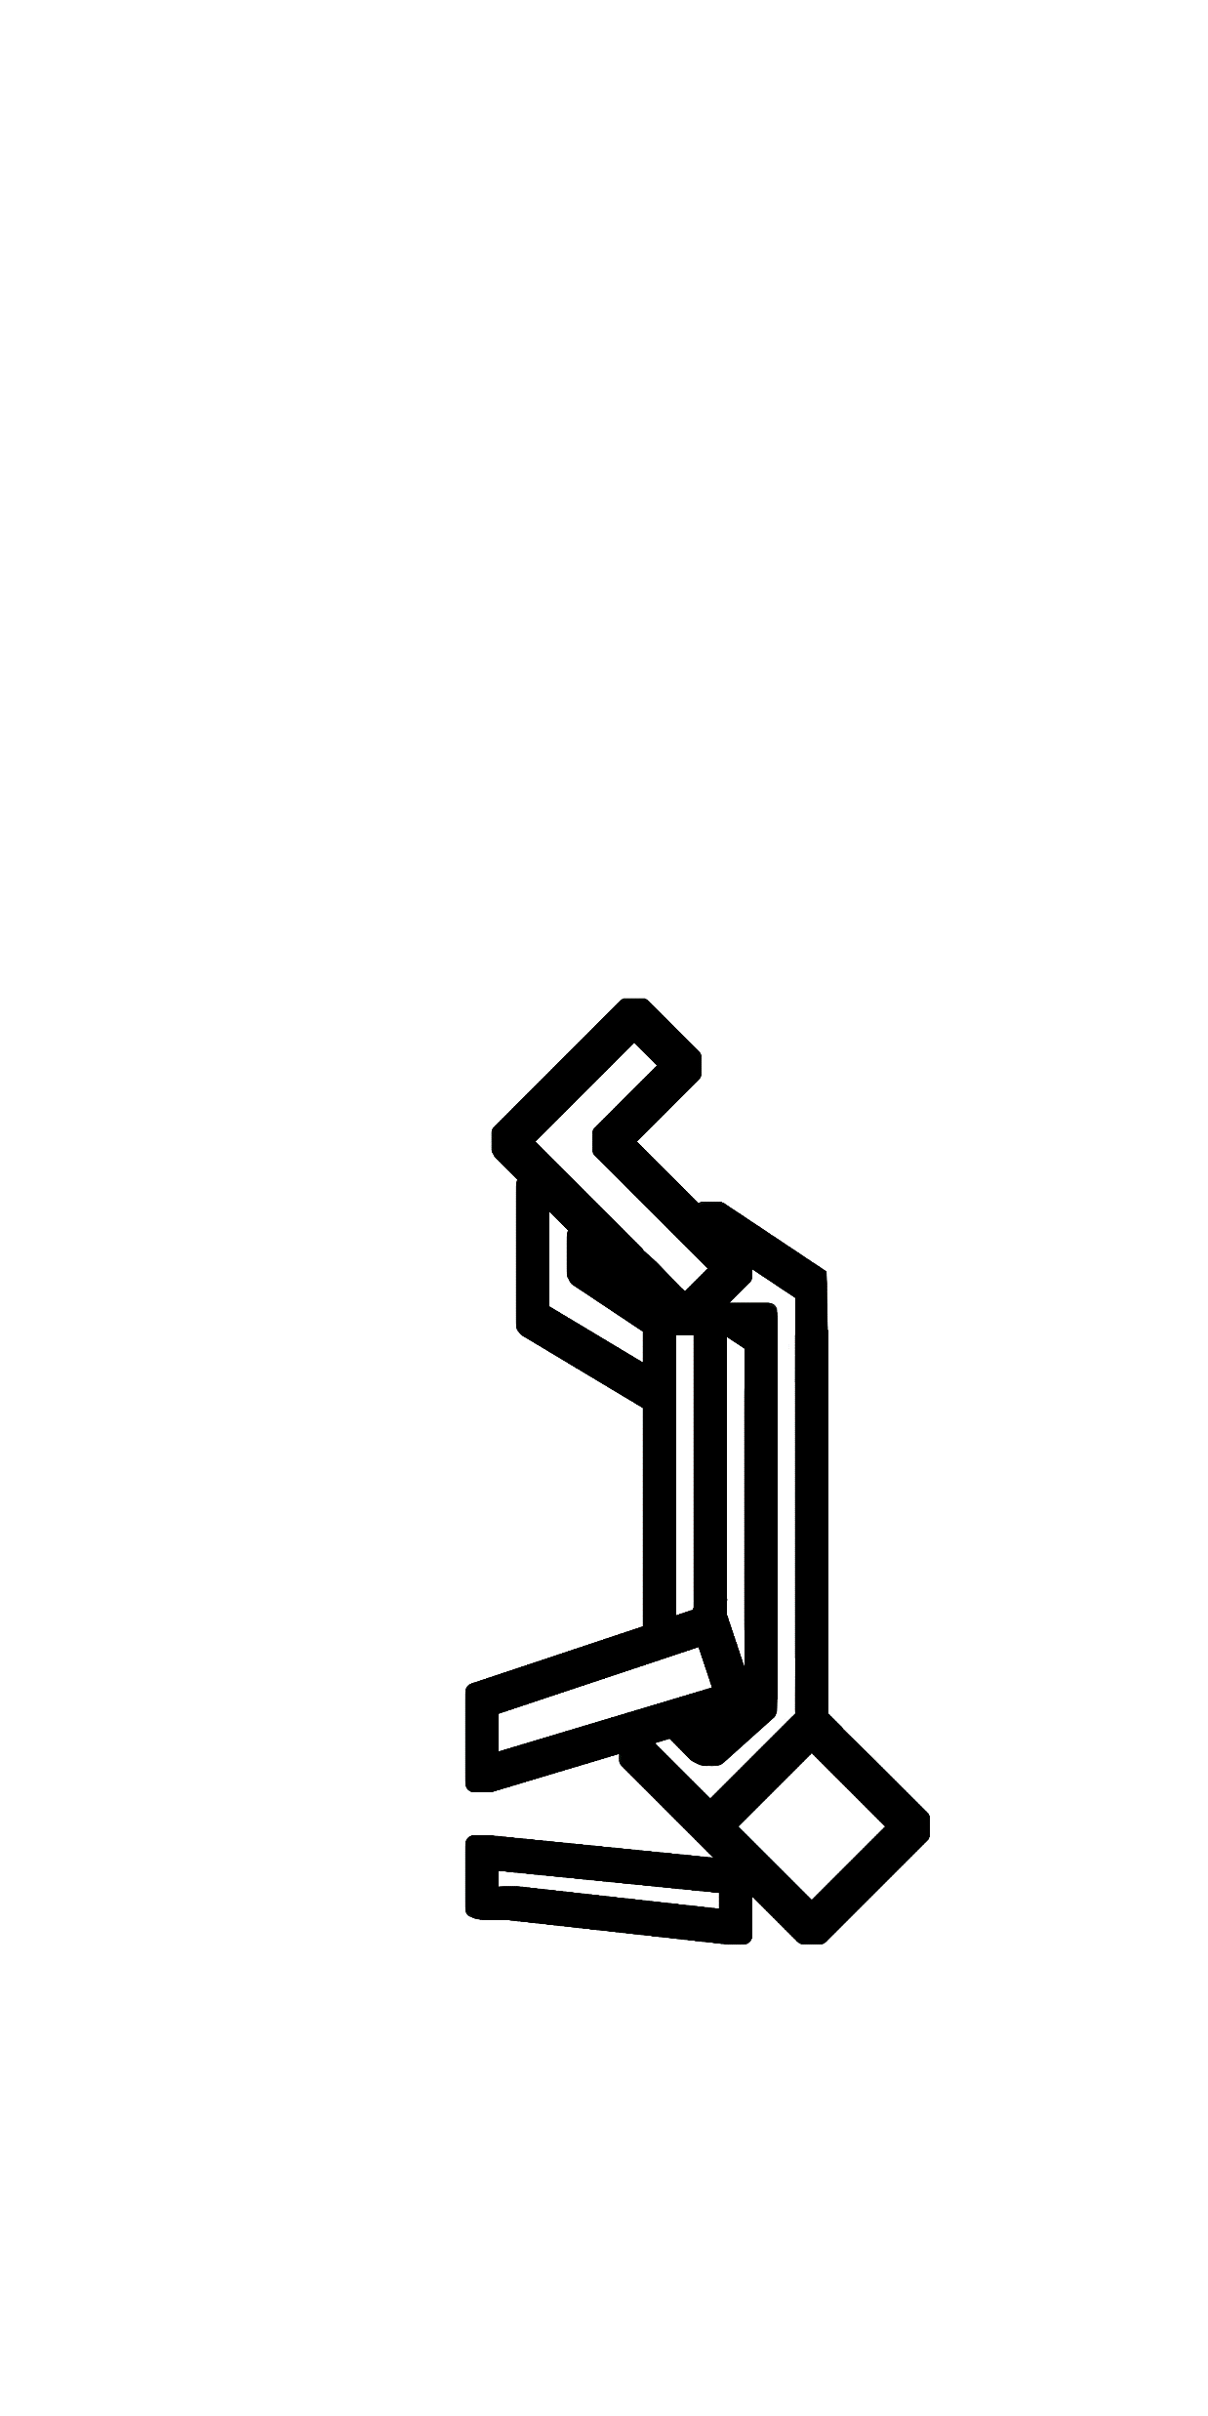
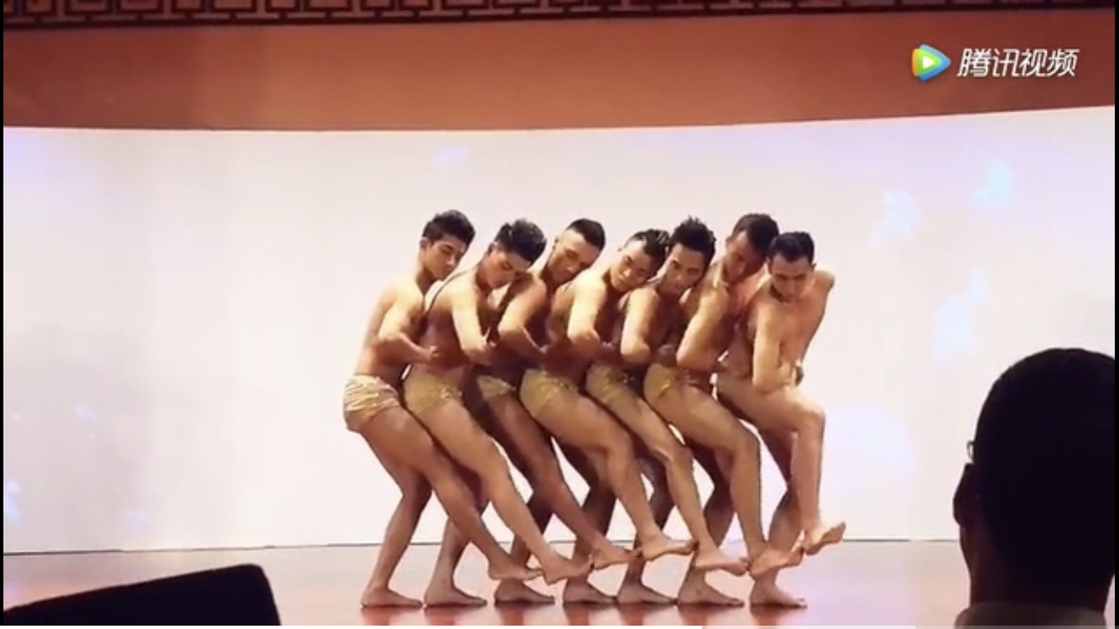
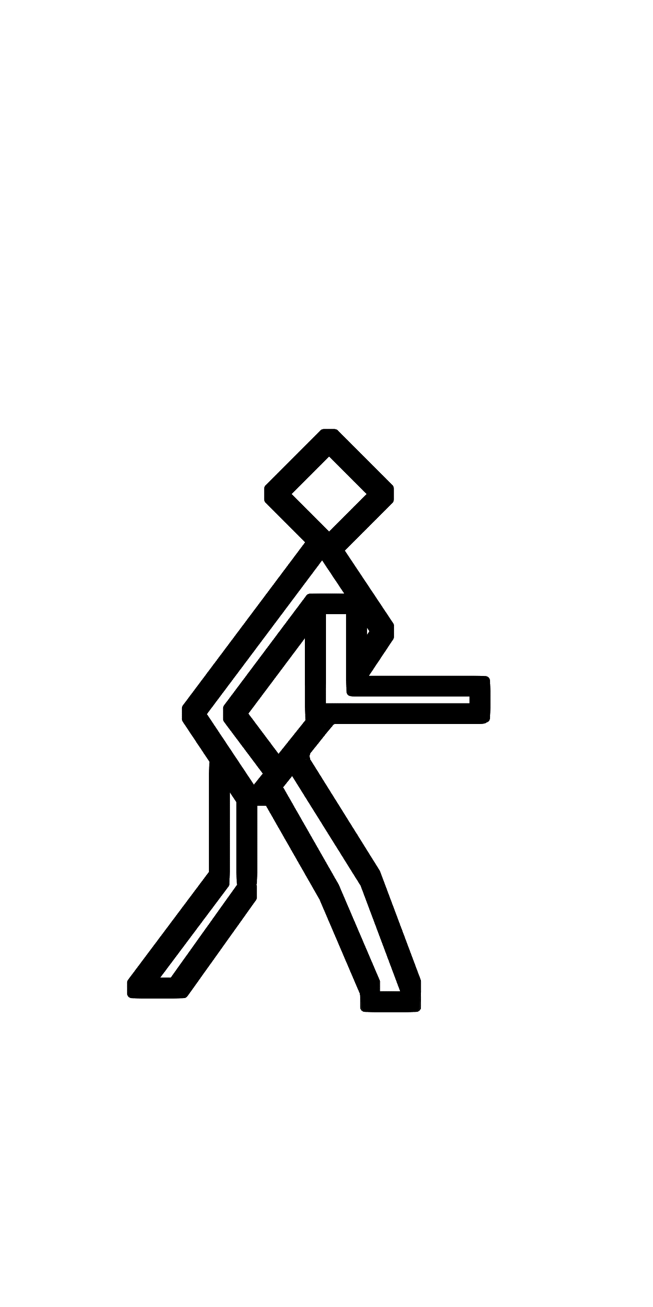
舞蹈符号（五）
Dance Symbol (5)
舞蹈符号（七）
Dance Symbol (7)
舞蹈符号（六）
Dance Symbol (6)

Slide 10
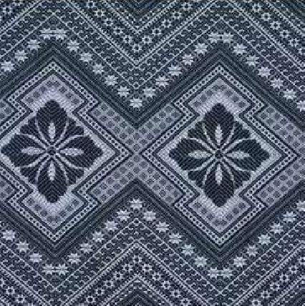
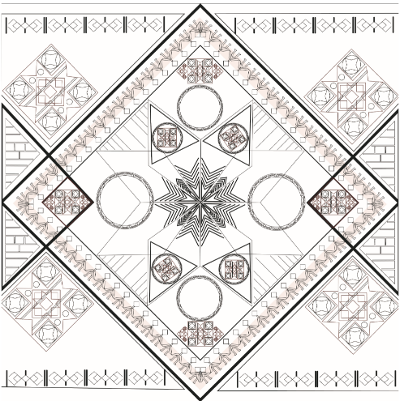

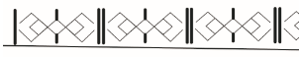

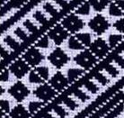
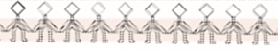
服饰纹样（一）
Dress pattern (1)
服饰纹样（二）
Dress pattern (2)
服饰纹样（三）
Dress pattern (3)
服饰纹样（四）
Dress pattern (4)

Slide 11
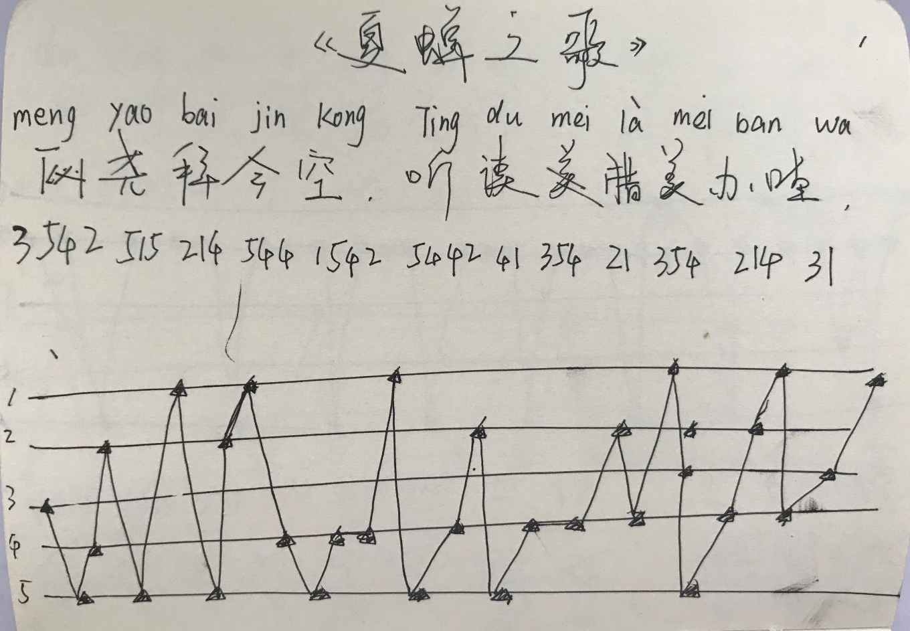
侗族大歌数据翻译
Dong song data translation
把歌曲用侗族语言翻译，然后用汉语拼音注释，再对26个字母用五进制进行编写，最后画在五线谱上，形成图案。
Translate songs into Dong language, And then annotate with Chinese Pinyin, Then 26 letters are written in quintiles， Finally, draw on the staff to form a pattern.
1

Slide 12
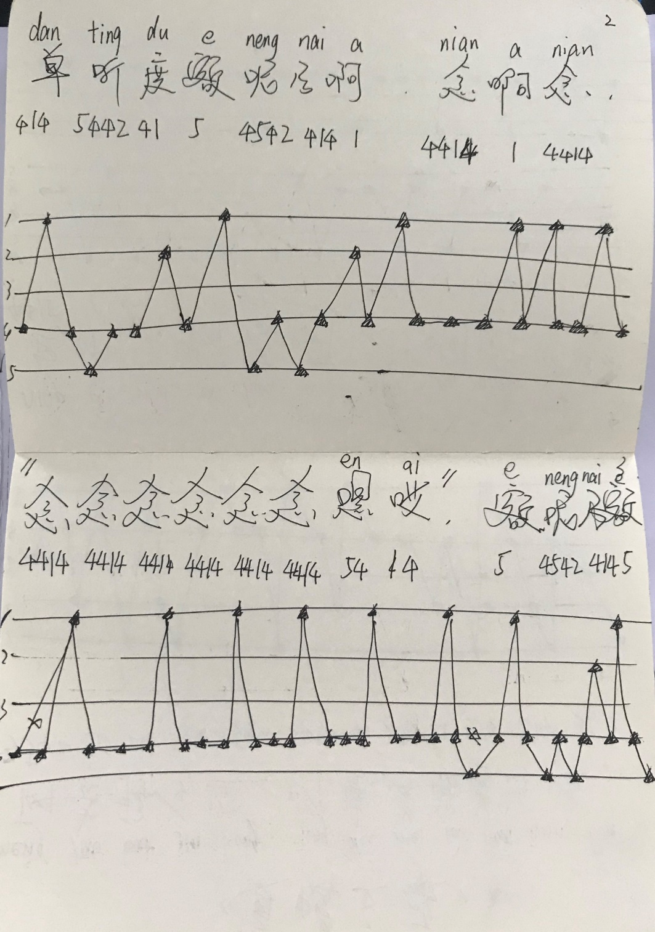
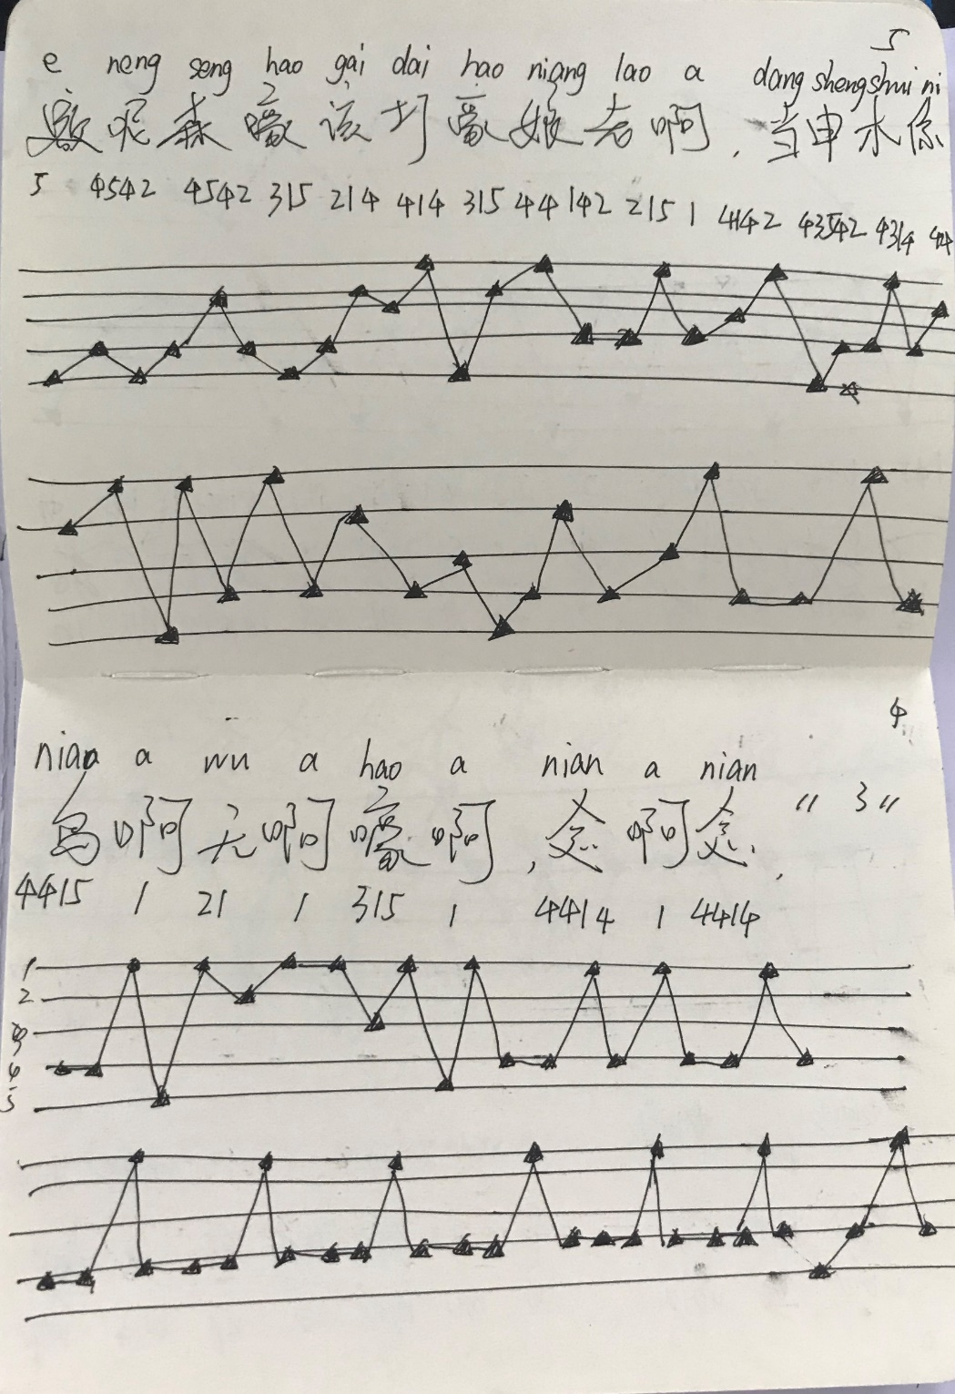
2
5
3
4

Slide 13
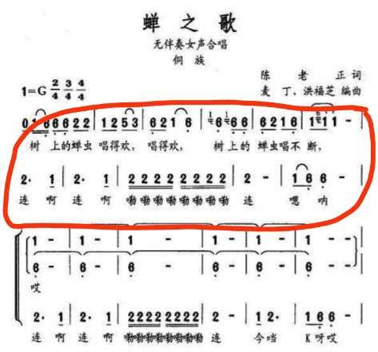
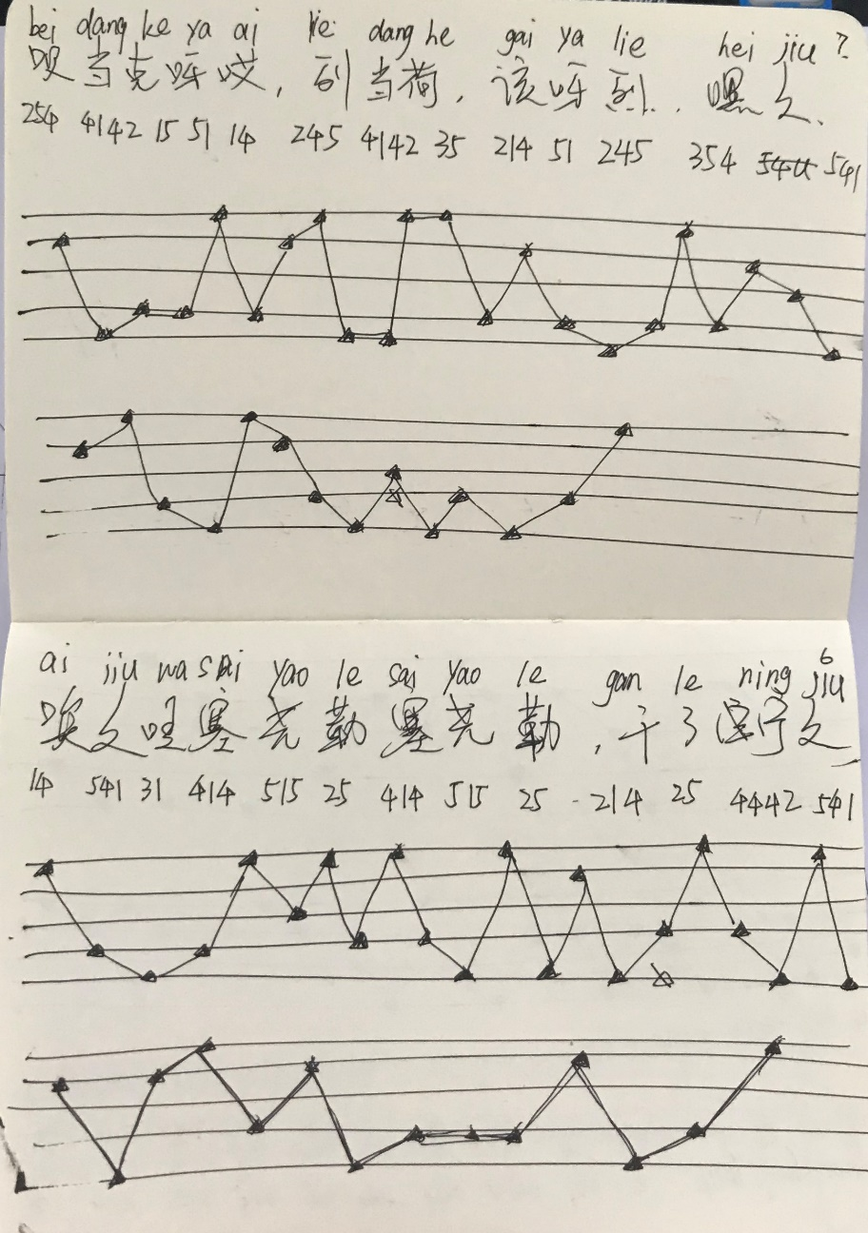
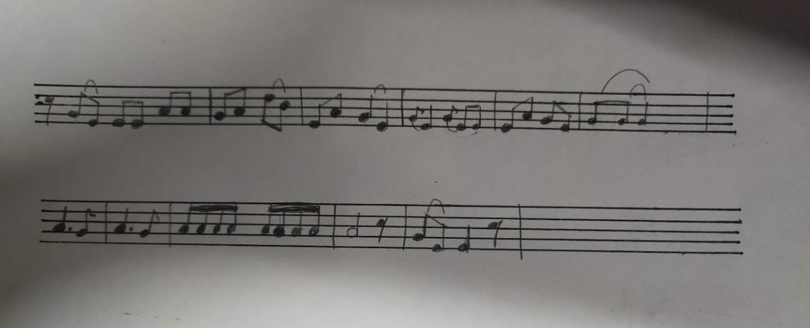
7
乐谱生成
Score generation
6

Slide 14
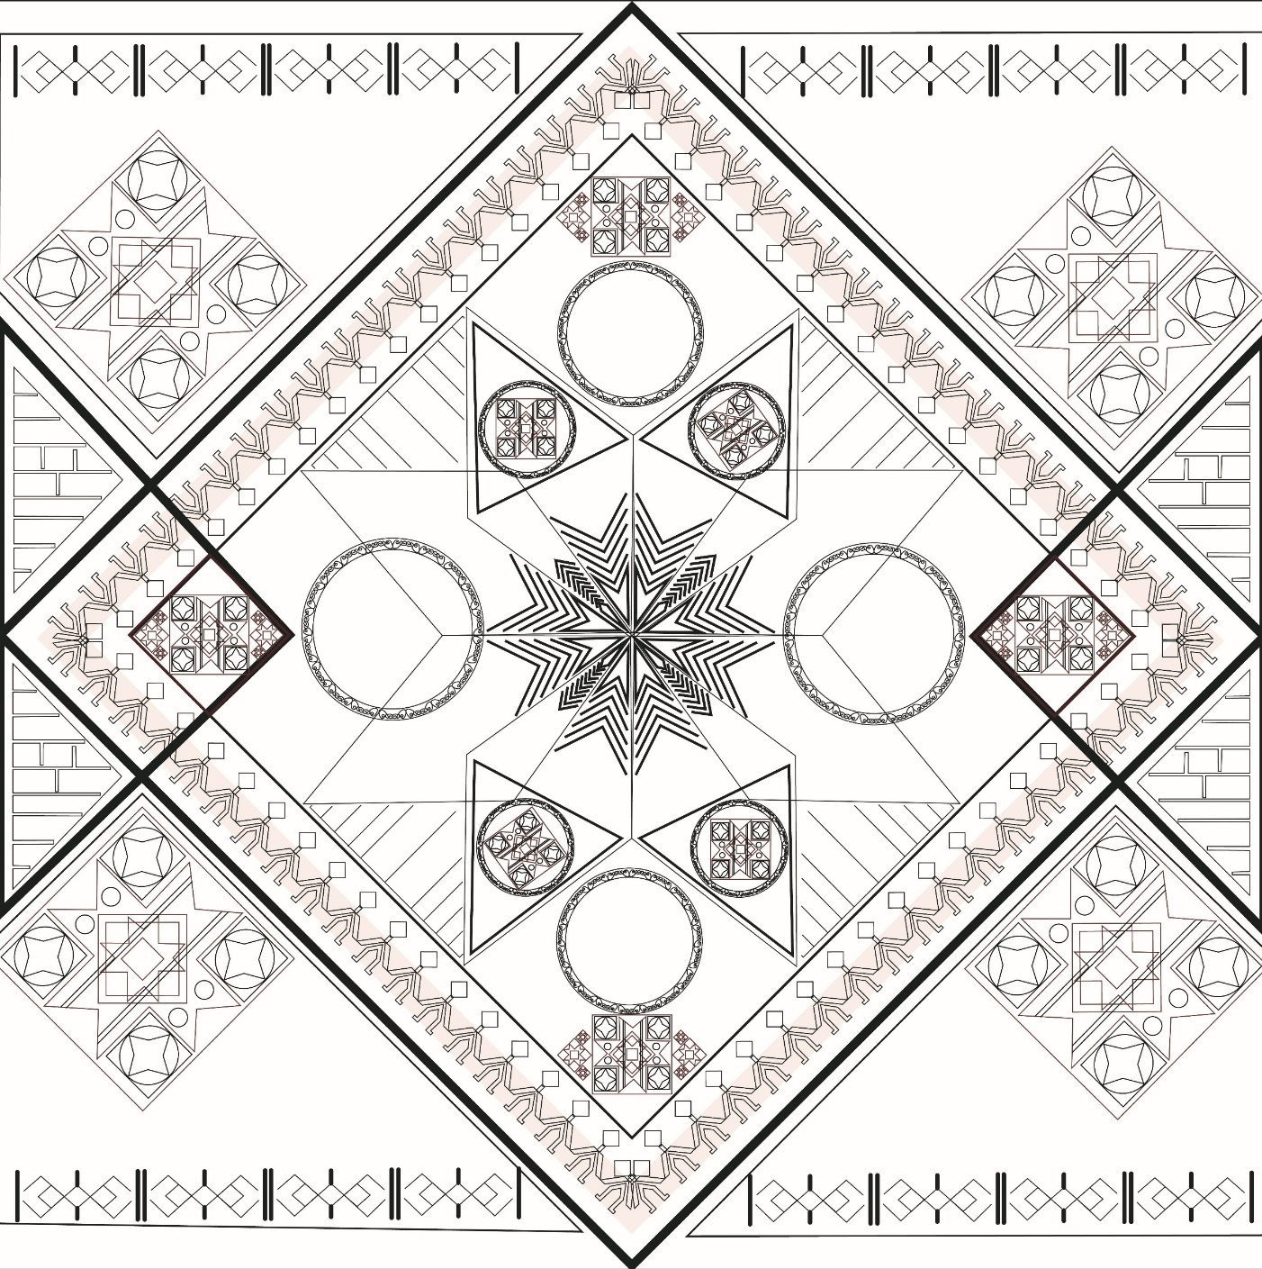
形成草图：
Form Sketches
服饰纹样草图
Dress pattern sketch

Slide 15
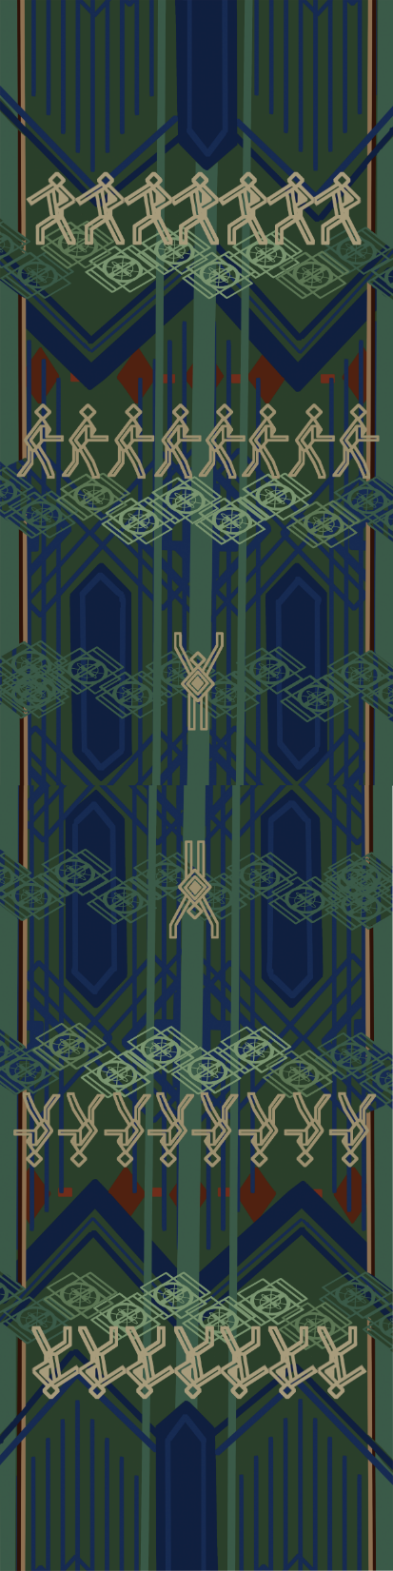
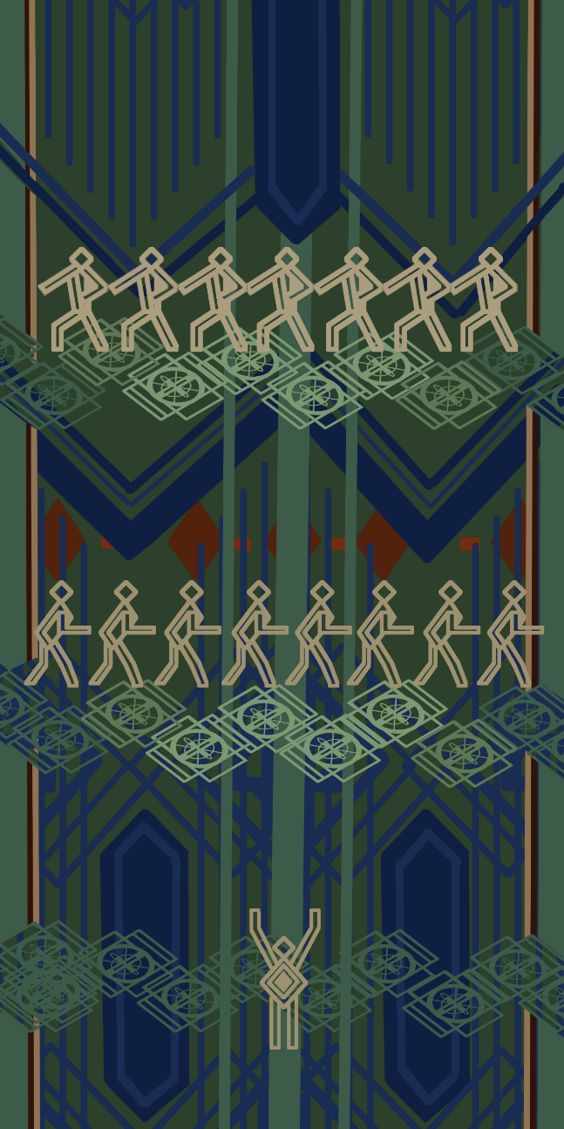
舞蹈纹样草图（完整）
Sketch of dance patterns (Complete)
舞蹈纹样草图（局部）
Sketch of dance patterns (local)

Slide 16
时间表：
Timetable
周二：（1）进一步完整数据统计，并对其进行再创造。（2）调整草图
周三： （1）进一步完整数据统计，并对其进行再创造。（2）调整草图
周四：（1）初步完成四幅主视觉 0.5*2m 的文稿，并修改
周五：（1）继续修改主视觉文稿，并确定最终文稿
周末：（1）对主视觉进行延伸创作，即八张 0.2*0.2m 的文稿 （2）与老师商量并修改至定稿 （3）联系淘宝打印店并打印（最迟下周一打印）
下周：对纹样进行数据化呈现
Tuesday: (1) Further complete data statistics and re-creation. (2) adjust the sketch.
Wednesday：(1) Further complete data statistics and re-creation. (2) adjust the sketch.
Thursday: (1) Four manuscripts with 0.5*2m main vision have been preliminarily completed and revised.
Friday： (1) Continue to modify the main visual document and determine the final document.
Weekend: (1) to extend the creation of the main vision, that is, eight 0.2*0.2m manuscripts. (2) Discuss with the teacher and revise to the final version. (3) Contact Taobao Printing Store and Print (Print by Next Monday at the latest, Because Taobao takes 2-3 days to ship.)
Next week: Data Presentation of Patterns

